Slide 1

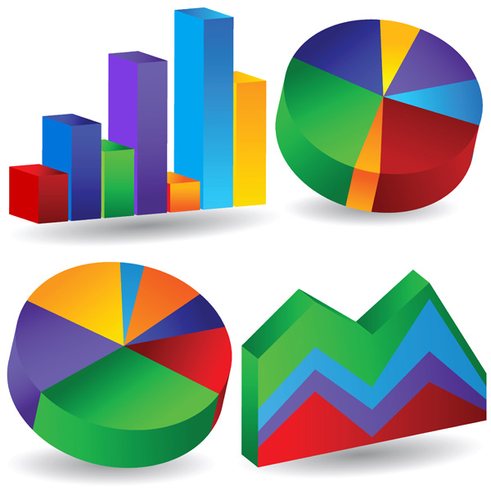

CASE STUDY 1: Collecting Data from Twitter
MELANIE JUTRAS
SUSHMA TAYANNA
RAHUL GHADGE
DEBRAJ ROY
PRANEETH NOOLI

Slide 2

OBJECTIVE:
Introduction to the field of data science by gathering, storing and analyzing sample twitter data.
Searching tweets, analyzing tweets and tweet entities with frequency analysis, and getting all “friends” and “followers” of a popular twitter user.
Coming up with a business question that twitter data could help to answer.

Slide 3

Twitter:
Twitter is an online social networking service that enables users to send and read short 140-character messages called "tweets“.
Registered users can read and post tweets, but those who are unregistered can only read them.
Users access Twitter through the website interface, SMS or mobile device app.

Slide 4

Why Pokemongo?
Its a free-to-play, location-based augmented reality game.
Game’s concept is awesome!!!.
Incentive to be more active in the real world.
Became a global phenomenon.
Was one of the most used and profitable mobile apps in 2016.

Slide 5





Process:

Slide 6

Data Collection
Collecting the Data:
First Approach- Polling API and JSON files
Final Approach – Streaming API and MongoDB,RoboMongo
Programming Environment used : Python 3
What we collected? :Tweets of “#PokemonGo”
Total tweets collected: 5000
Started with more data, but now we have 5000 tweets due to data corruption.

Slide 7
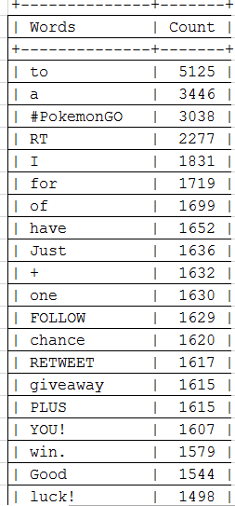
Data Findings: Popular words

Slide 8
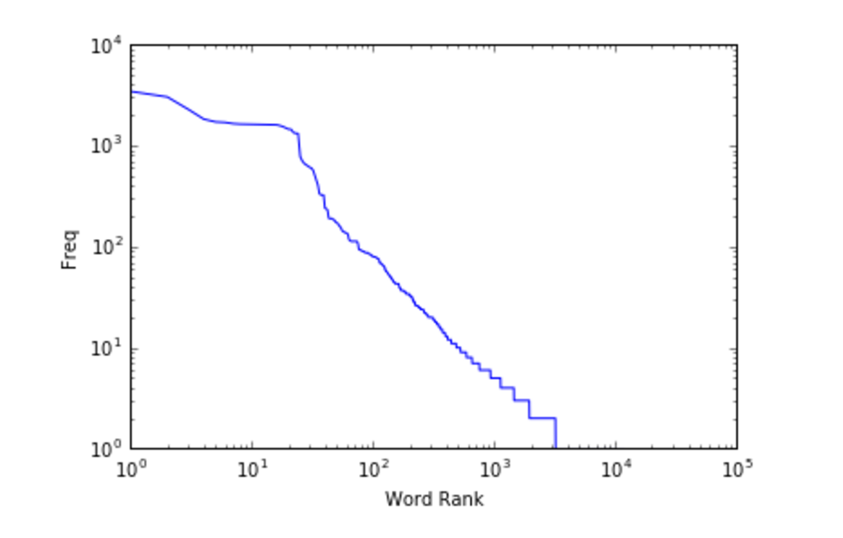
Frequency Analysis

Slide 9
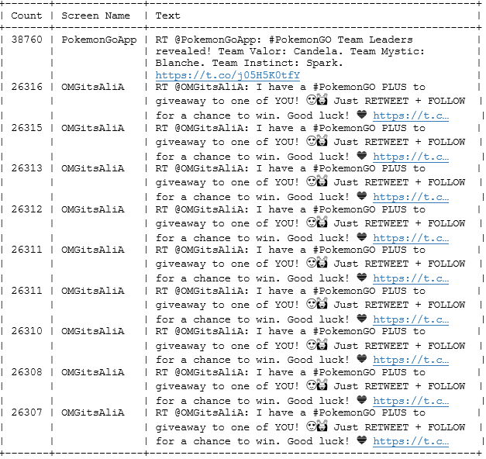
Data Findings-Top 10 Retweets

Slide 10
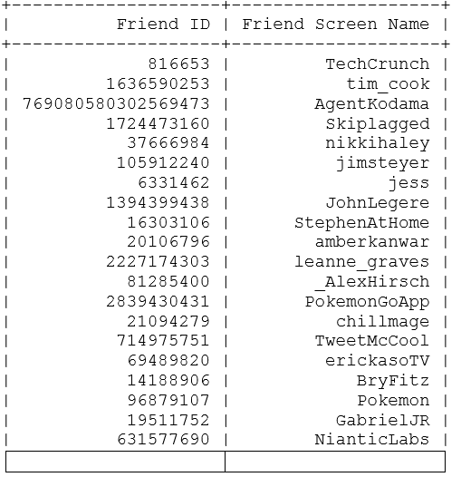
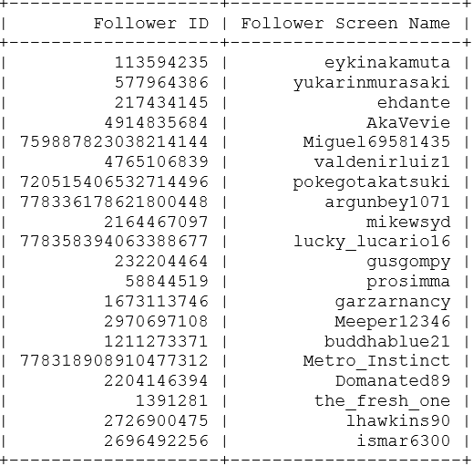
Popular User
We chose to do a search using the screenname @JohnHanke .
John Hanke is the CEO of Niantic labs, the company that makes the PokemonGo appList of Followers, friends and Mutual friends.
We fetched 327 total friends and 5000 followers.
Friends List Followers List

Slide 11

DATA ANALYSIS
1. Analysis of the data was performed in order to understand what all of these #PokemonGo tweets were about.
2.RoboMonGo to view and analyze data effectively.
3. Analysis of geolocation of general tweets about the Pokemon Go application as well as specific tweets about the Pokemon characters as they relate to location.
4.Tweet location (Co-ordinates) is off by default → Biased data.
( Note: We tried user location ,But it can have garbage data!!!)
http://bl.ocks.org/d/1921b74a3dad5410200097440ae7bb2b

Slide 12
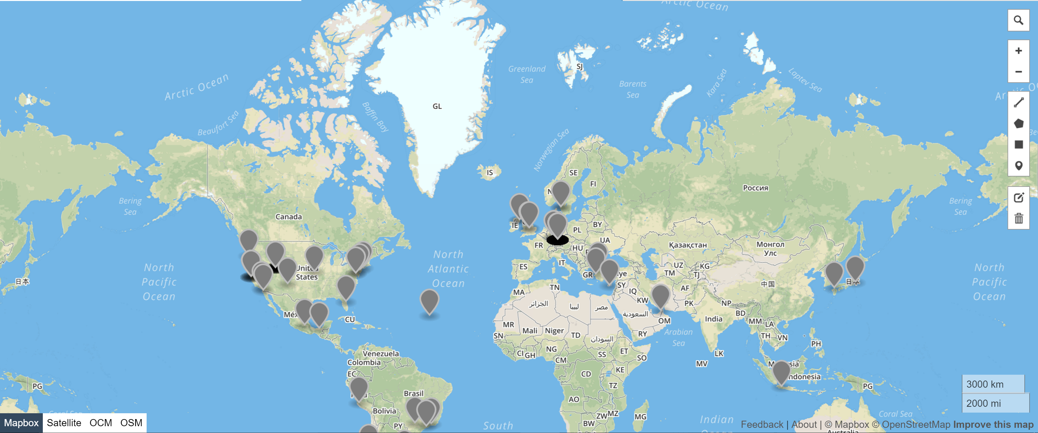

Slide 13

Business Use Case:
“Can the content and location of user’s tweets about the PokemonGo application provide useful information for future business decisions?”
The business case involves finding the location of where people are tweeting about PokemonGo as well as whether or not tweets about particular Pokemon characters are somehow tied to location.
If it can be determined that a location has very few tweets, the company may do an analysis of where Pokestops exist or which Pokemon characters might appeal to a particular location to try and attract more users

Slide 14


Future Scope
As discussed, geo location is turned off by default for twitter users. In order to draw conclusions based on location one would need to compile a considerable amount of data for analysis.
Additionally, user sentiment is an area of great importance when analyzing tweets. The number of times someone tweets about a topic means nothing if we do not know whether the tweets are positive or negative.
Identifying popularity of each Pokemon character along with user sentiment in various geo locations in order to determine whether specific new characters should be released only in certain geographic locations in the future

Slide 15

Conclusion
We have gathered, analyzed and summarized data for thousands of tweets about the topic of the popular mobile application PokemonGo.
With millions of players all over the world, there is great potential to determine future marketing plans and budgeting of resources.
With the explosion of the internet of things, this data will continue to increase in volume and provide invaluable business insight

Slide 16


